Slide 1
Python Functions
Life Choices Coding Academy 2020

Slide 2
Learning Outcome
Write basic python Functions

Slide 3
Intro to Python Functions
A functions is a block of code which only runs when it is called,
You can pass data, known as parameters, into a function.
A function can return data as a result.
Notes:
Functions perform a collections of tasks, bundled under a specific name. Take input argument(s), execute statements(s), return output.
Input and output can be of all different types.

Slide 4

Creating a Function
A function is defined using the def keyword.

Slide 5
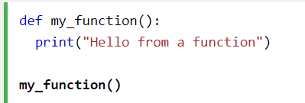
Calling a Function
To call a function, use the function name followed by parenthesis.
Notes:
You can call a function as many times as you want.

Slide 6
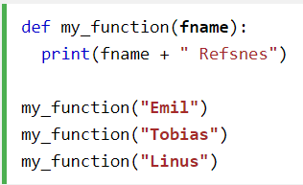
Function Arguments
Information can be passed into functions as arguments.
Specified after function name, inside the parentheses
You can as many arguments as you want.
Just separate them with a coma.
Notes:
This example has a function with one argument(fname). When the function is called, we pass along a first name, which is used inside the function to print the full name.
Arguments are often shortened to args in Python documentations.
By default, a function must be called with the correct number of arguments. Meaning that if your function expects 2 arguments, you have to call the function with 2 arguments, not more, and not less.
Demonstrate what happens when you do not use the right number of arguments.

Slide 7
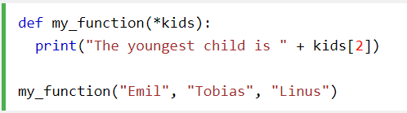
Arbitrary Arguments, *args
If the number of arguments is unknown add * before the parameter name
Notes:
Arbitrary Arguments are often shortened to *args in Python documentations.

Slide 8
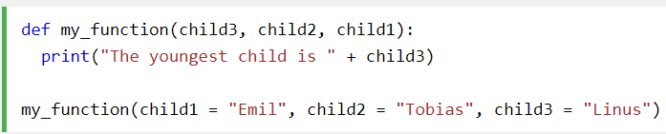
Keyword Arguments
You can also send arguments with key -value syntax.
The order of the arguments does not matter here.
Notes:
The phrase Keyword Arguments are often shortened to kwargs in Python documentations.

Slide 9
Arbitrary Keyword Arguments, **kwards
If you do not know how many keyword arguments that wit will be passed into your function,
Add two asterisks: ** before the parameter name in the function definition.
This way the function will receive a dictionary of arguments,
Notes:
The phrase Keyword Arguments are often shortened to kwargs in Python documentations.

Slide 10
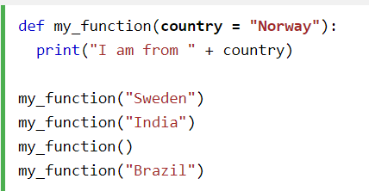
Default Parameter Value
If we call the function without argument, it uses the default value
Notes:
Results:
I am from Sweden
I am from India
I am from Norway
I am from Brazil

Slide 11
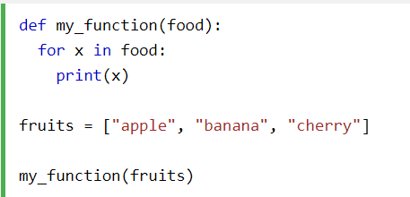
Passing a List as an Argument
You can send any data types of argument to a function
It will be treated as the same data type inside the function.
Notes:
E.g If you send a List as an argument, it will still be a List when it reaches the function.
Output
apple
banana
cherry

Slide 12
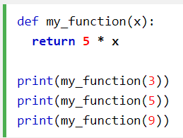
Return Values
To let a function return a value, use the return statement.
Notes:
Return gives something back or replies to the caller of the function while print produces text

Slide 13
Exercise time :)

Slide 14
Exercise 1
Write a function called distance_from_zero, with one argument (choose any argument name you like). If the type of the argument is either int or float, the function should return the absolute value of the function input. Otherwise, the function should return “Nope”.
Check if it works by calling the function with -5,6 and “what?”
Exercise 2
https://www.hackerrank.com/challenges/write-a-function/problem
Notes:
For exercise two, visit the link above.

